Slide 1
IXP TRAFFIC PATTERN
USAGE PATTERN FROM IXP PUBLIC SHARED TRAFFIC DATA IN SEE COUNTRIES
A COLLABORATIVE PROJECT ( AND A REQUEST FOR COOPERATION )
Gianluca Sironi Special Projects NAQUADRIA | PCIX
www.naquadria.it
SEE 12 | 22-23 April 2024 | Athens, Greece

Slide 2
CONTEXT
ITNOG (the ITalian Network Operators Group) «initiative» started @ MI-NOG (Milano-NOG) meetings ( dinners ☺ )
Initial analysis on IXPs Internet traffic data (starting from IXPManager-based IXPs JSON public data)
Focus on short to mid term (hours, specific daily timeframes, specific events, days, …)
Low budget ( and no costs for IXPs )
NOT A COMPETITION ←
www.naquadria.it
SEE 12 | 22-23 April 2024 | Athens, Greece

Slide 3
PROJECT OBJECTIVES
(INITIAL) Project objectives:
COLLECT IXPs traffic public data
AGREE and SHARE data, metrics, parameters and statistics (e.g. which metrics for Intra-IX D2D, W2W, etc…)
DEFINE (and agree) datasets to be published (available for researchers / IXs / everybody ?)
EXTEND «IXPmanager-based» IXs set
ADD other IXPs traffic (pubblic) data
EXTRACT features sets → FOCUS on TIME patterns
EVALUATE IXP «scale effect» & country based costraints
( create a WG / observatory ? )
www.naquadria.it
39th Euro-IX Forum, Prague, Czechia Nov 19-22 2023

Slide 4
COLLECTING TRAFFIC DATA
At this (initial) project stage we are gathering and collecting public traffic data only from «IXPManager-based» IXPs ( at pratically no cost for IXPs )
Already talking with other IXPs (starting from Italian ones) for a public traffic data interface (if any) API (JSON?) … (waiting for a feeback / API endpoints / dataset exports?)
www.naquadria.it
39th Euro-IX Forum, Prague, Czechia Nov 19-22 2023

Slide 5
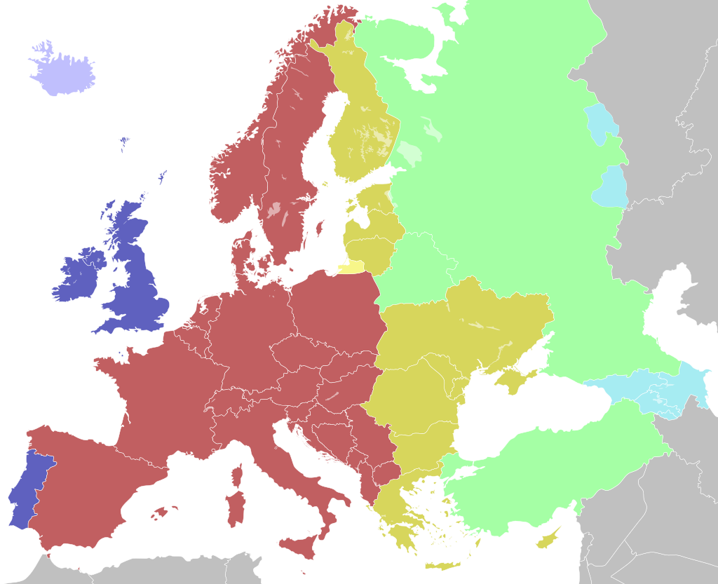
IXPs SET (based on IXPManager)
see https://www.ixpmanager.org/community/user-list
IT (MINAP, NAMEX)
IE (INEX)
GB (LONAP, NCL-IX)
SE (STHIX)
DE (BCIX, DO-IX, …)
NL (DATAIX, FRYS-IX, …)
[…]
source: https://en.wikipedia.org/wiki/Central_European_Time#/media/File:Time_zones_of_the_Greater_Europe.svg
www.naquadria.it
SEE 12 | 22-23 April 2024 | Athens, Greece

Slide 6
IXPs in SEE (based on IXPManager)
see https://www.ixpmanager.org/community/user-list
GR (GR-IX)
AL (ANIX)
HR (CIX)
RO (INTERLAN)
BA (BHNIX)
MK (IXP)
source: https://en.wikipedia.org/wiki/Central_European_Time#/media/File:Time_zones_of_the_Greater_Europe.svg
www.naquadria.it
SEE 12 | 22-23 April 2024 | Athens, Greece

Slide 7
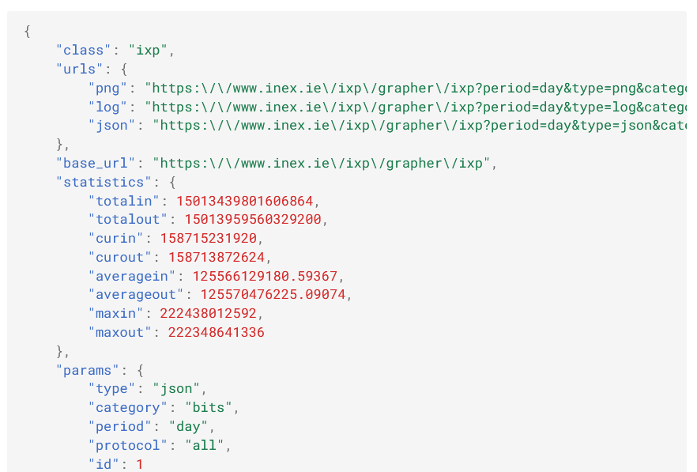
Traffic data ( public API )
https://ixp.example.com/grapher/{graph}[?id=x][&period=x][&type=x].....
API access
current traffic
[bps]
source: https://docs.ixpmanager.org/grapher/api/
www.naquadria.it

Slide 8
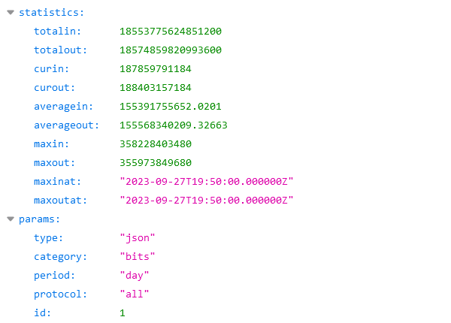
JSON 2 CSV (e.g.) TS dataset
ISO 8601 timestamp
Mon to Sun week
10m «sampling»
144 samples / day
1008 samples / week
~ 53k samples / year
e.g CSV dataset record: YYYYMMDDThhmmssZ,187859791184,188403157184[,…]
www.naquadria.it
SEE 12 | 22-23 April 2024 | Athens, Greece

Slide 9
Collected traffic data & statistics
DIMENSIONAL PARAMETERS (DAILY/WEEKLY)
min | min → range=(max-min)
avg | sd | MAD
1Q | median | 3Q → IQR=(3Q-1Q)
(5p) | 10p | 90p | (95p)
ADIMENSIONAL PARAMETERS:
max/avg | max/min
CV (=sd/avg) | median/avg | skewness | …
NORMALIZATION:
min-max normalization | mean normalization | standardization (z-score) | ( modified z-score ) | …
www.naquadria.it
SEE 12 | 22-23 April 2024 | Athens, Greece

Slide 10
Collecting other IXPs data
From PEERING DB # peers ( no specific API available yet )
Retrieving info from https://www.peeringdb.com/ix/${ixpid}
-----------------------
20240331T180000Z
IXPID,IXPName,Peers
240,MINAP Milan,86
121,Namex Rome,163
48,INEX LAN1,106
387,INEX LAN2,65
53,LONAP,263
303,CIX,36 …
-----------------------
20240415T180001Z
IXPID,IXPName,Peers
240,MINAP Milan,88
121,Namex Rome,163
48,INEX LAN1,105
387,INEX LAN2,65
53,LONAP,268
303,CIX,36
…
www.naquadria.it
SEE 12 | 22-23 April 2024 | Athens, Greece

Slide 11
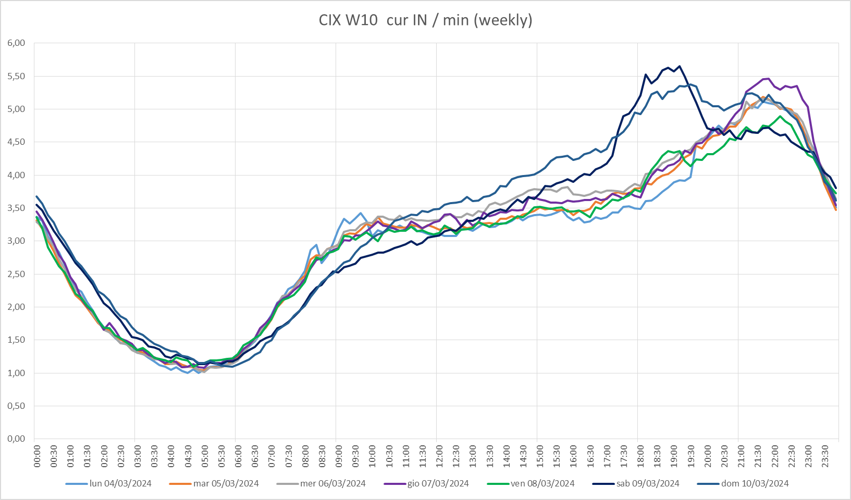
CIX W10 [weekly min]E-1
www.naquadria.it
SEE 12 | 22-23 April 2024 | Athens, Greece

Slide 12
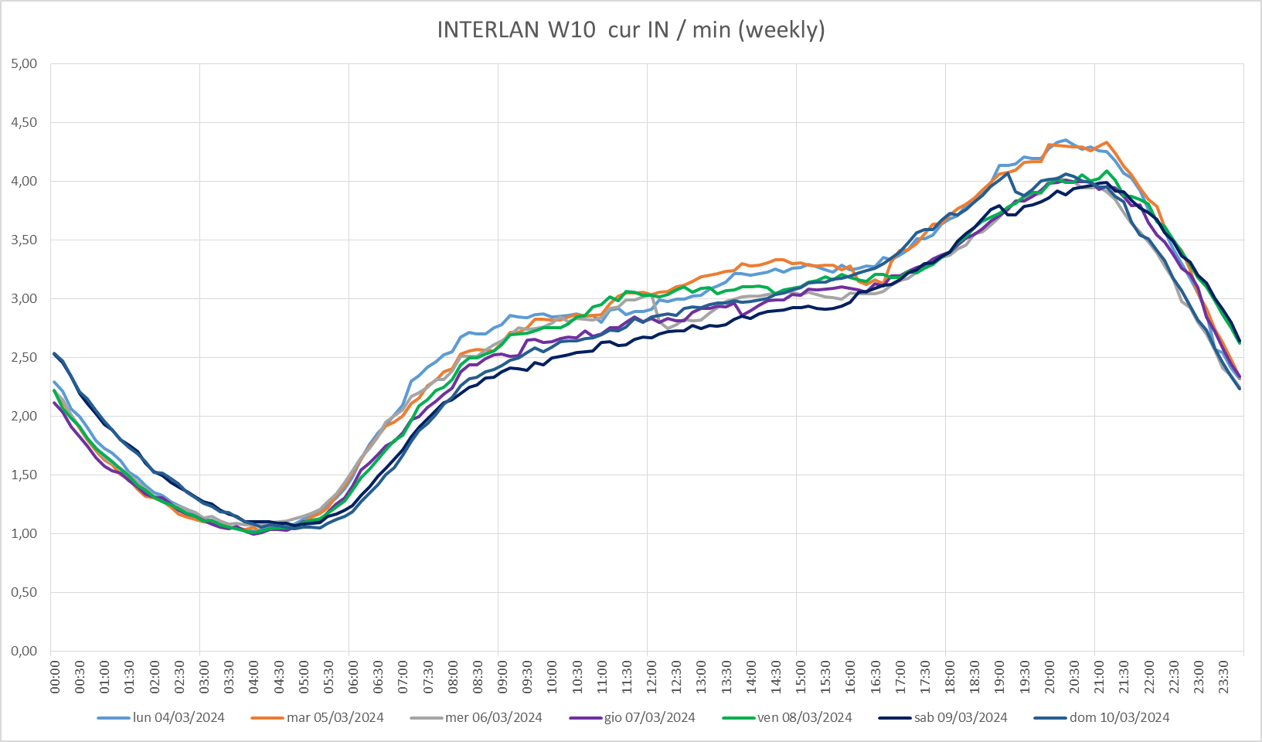
INTERLAN W10 [weekly min]E-1
www.naquadria.it
SEE 12 | 22-23 April 2024 | Athens, Greece

Slide 13
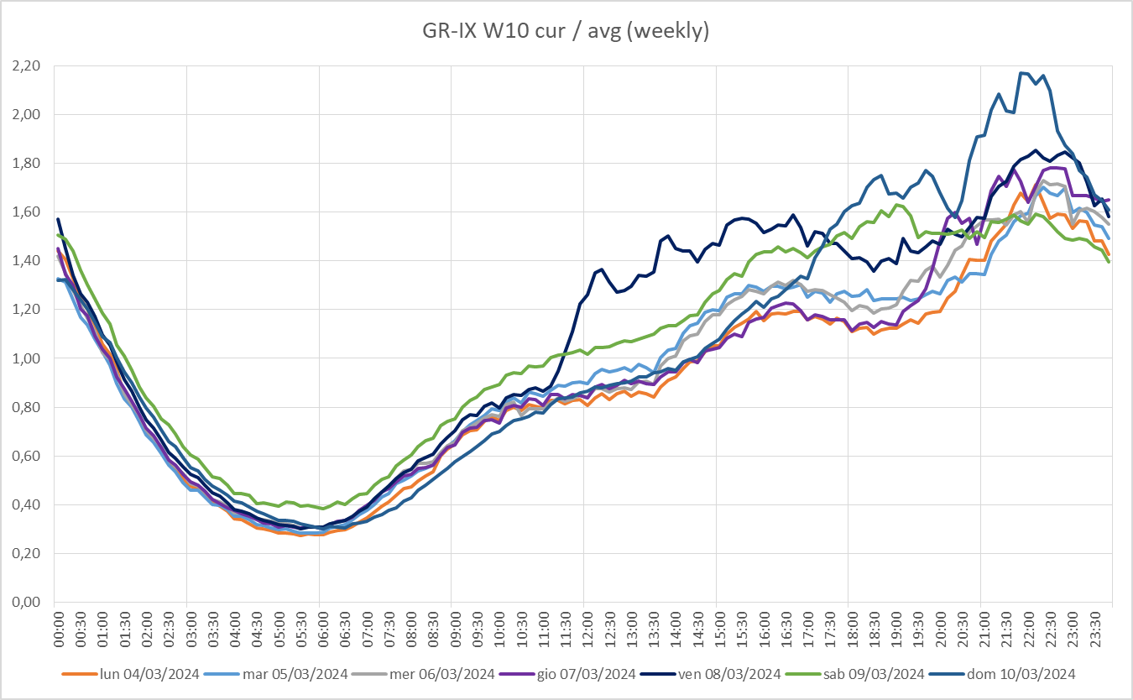
GR-IX W10 (normalized to avg)
www.naquadria.it
SEE 12 | 22-23 April 2024 | Athens, Greece

Slide 14
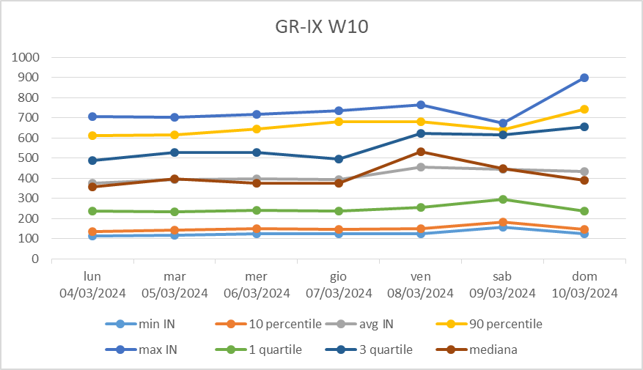
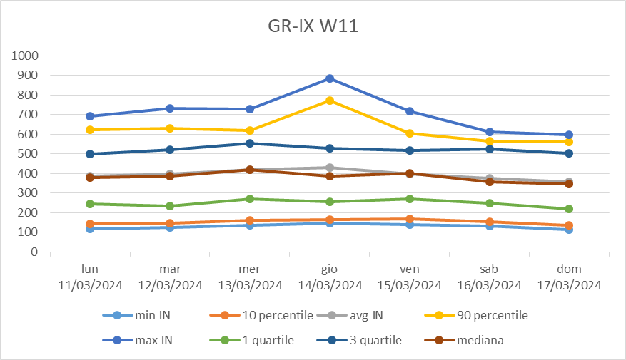
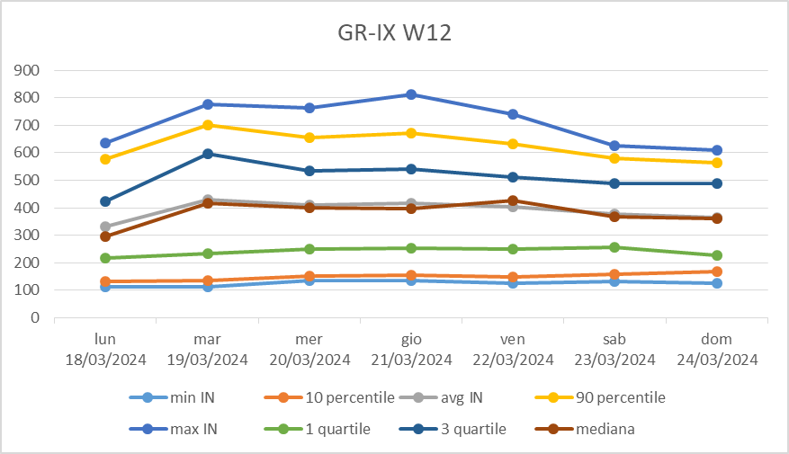
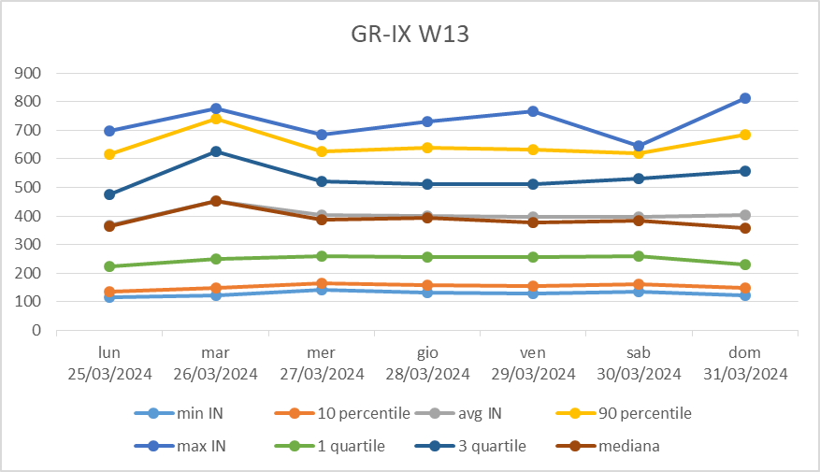
www.naquadria.it
SEE 12 | 22-23 April 2024 | Athens, Greece

Slide 15
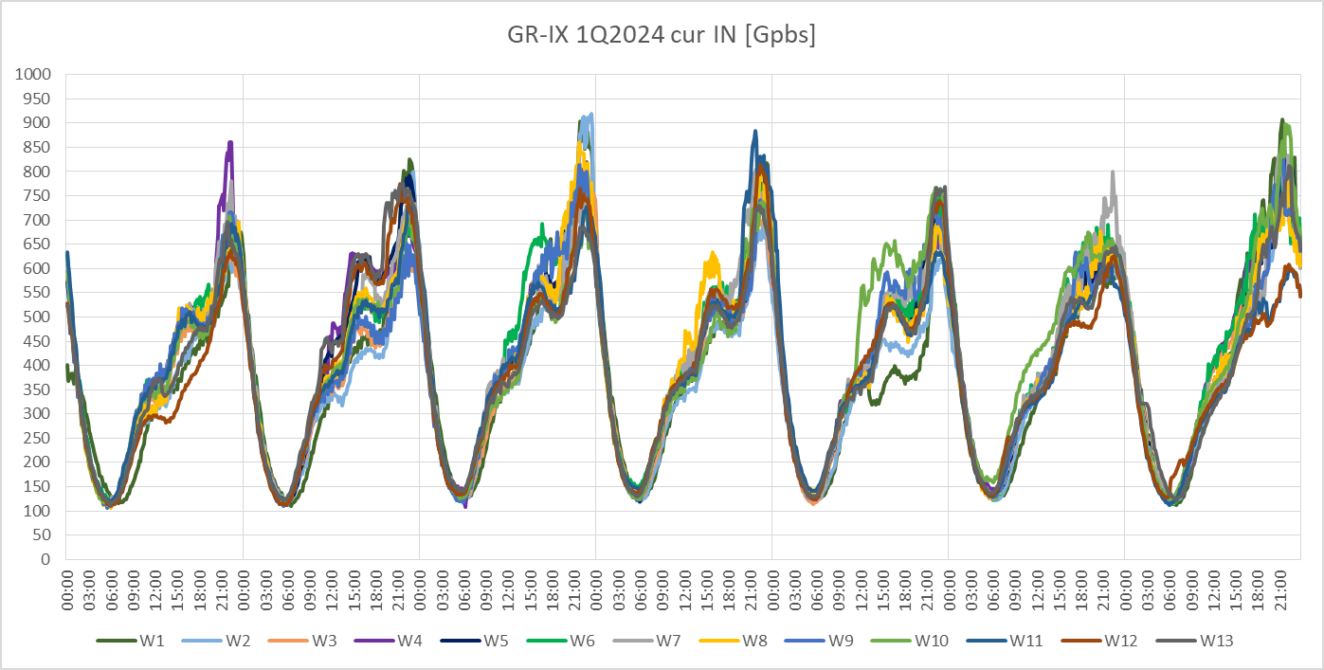
GR-IX TRAFFIC 1Q2024
www.naquadria.it
SEE 12 | 22-23 April 2024 | Athens, Greece

Slide 16
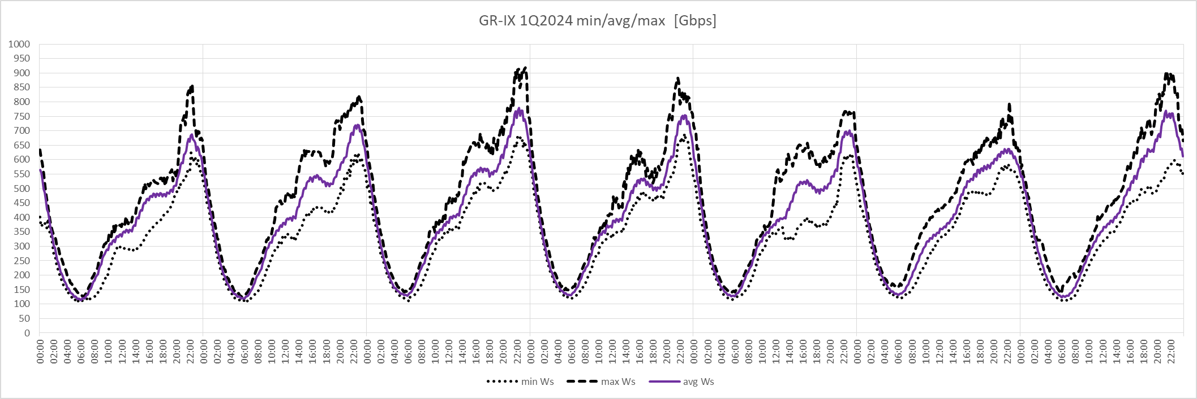
GR-IX 1Q2024 min/avg/max
www.naquadria.it
SEE 12 | 22-23 April 2024 | Athens, Greece

Slide 17
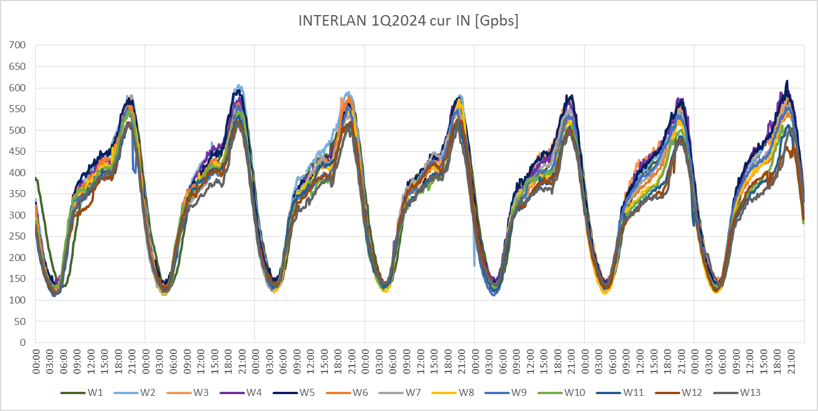
INTERLAN TRAFFIC 1Q2024
www.naquadria.it
SEE 12 | 22-23 April 2024 | Athens, Greece

Slide 18
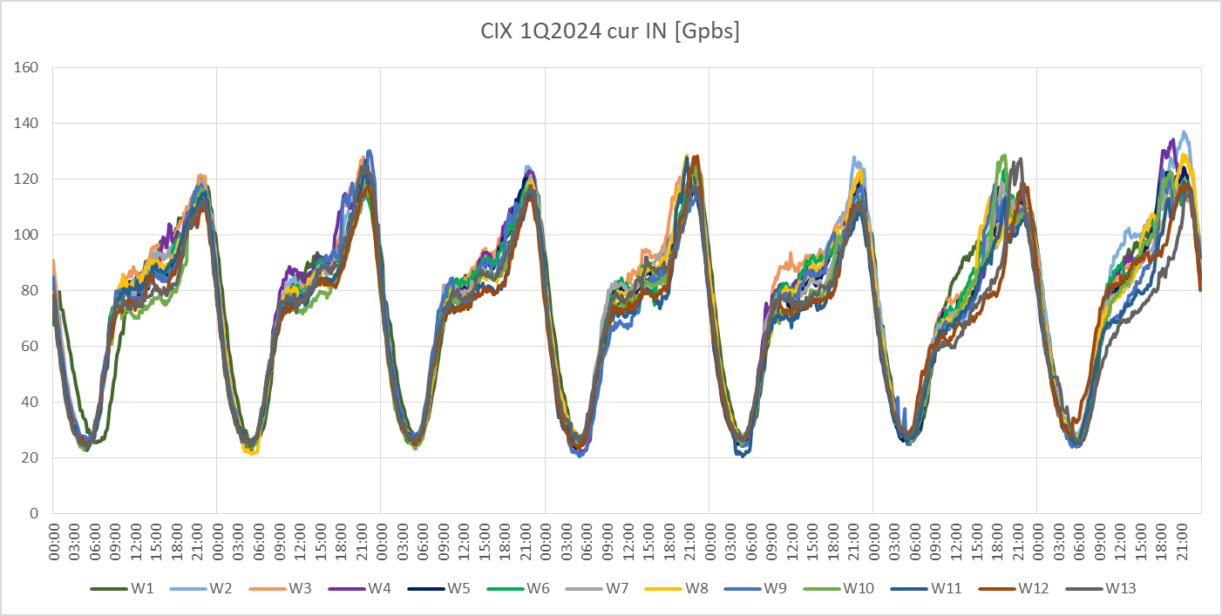
CIX TRAFFIC 1Q2024
www.naquadria.it
SEE 12 | 22-23 April 2024 | Athens, Greece

Slide 19
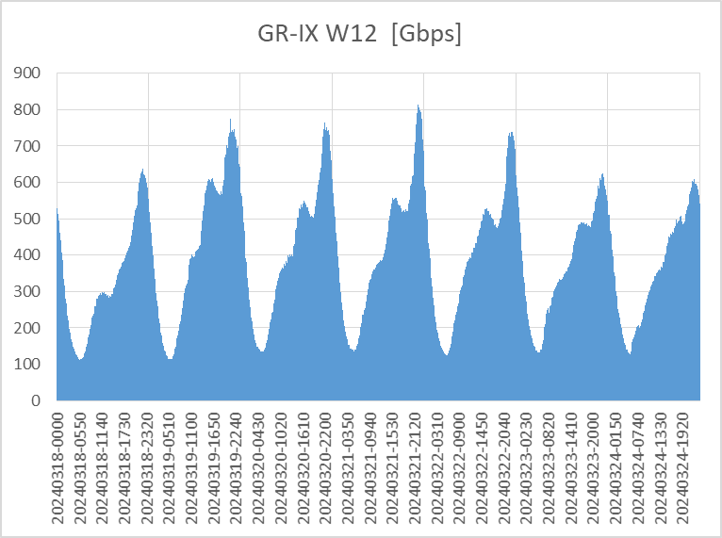
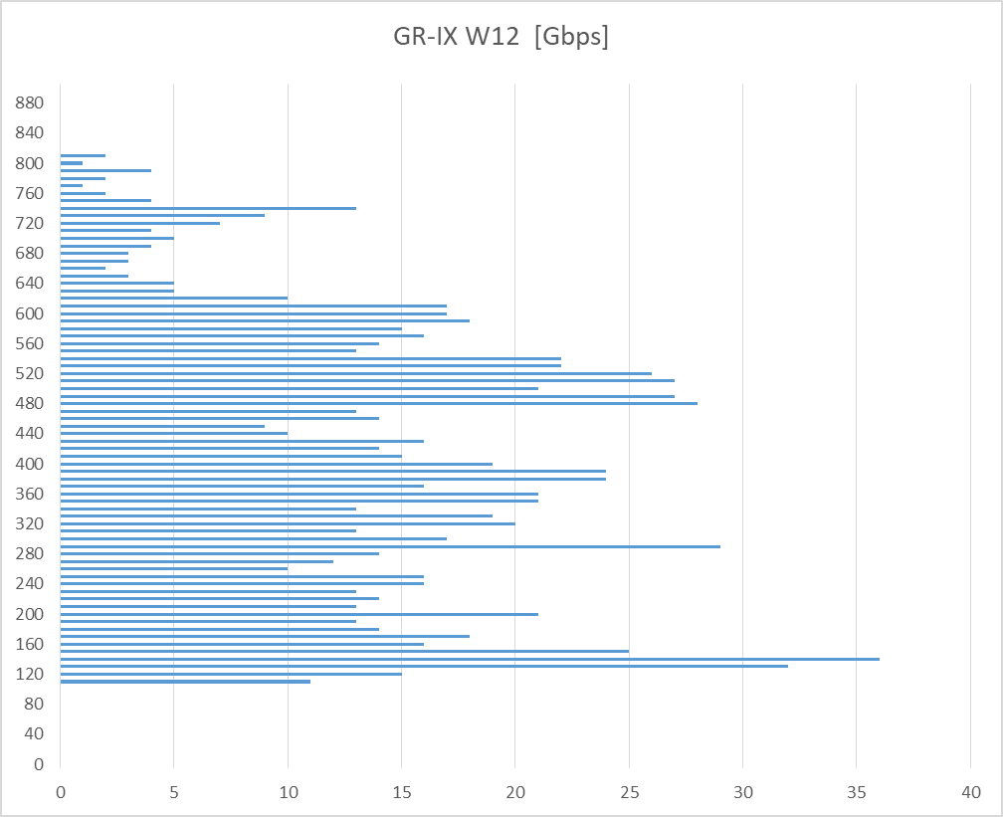
TRAFFIC & FREQ (tens of Gbps)
www.naquadria.it
SEE 12 | 22-23 April 2024 | Athens, Greece

Slide 20
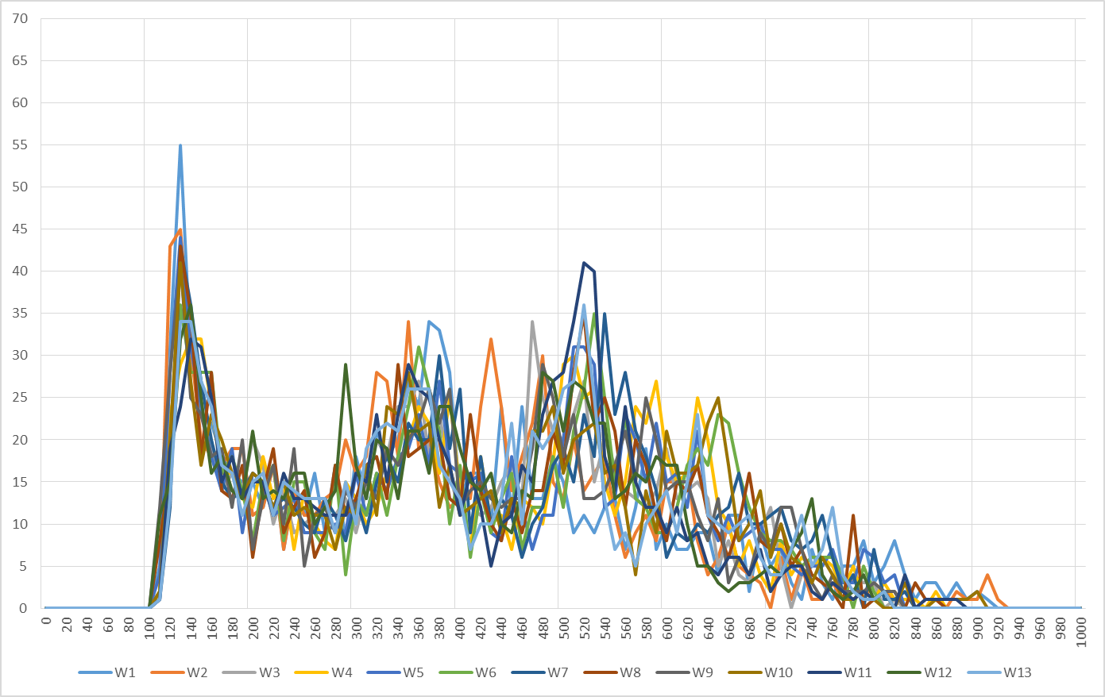
GR-IX (tens of Gbps freq) 1Q2024
www.naquadria.it
SEE 12 | 22-23 April 2024 | Athens, Greece

Slide 21
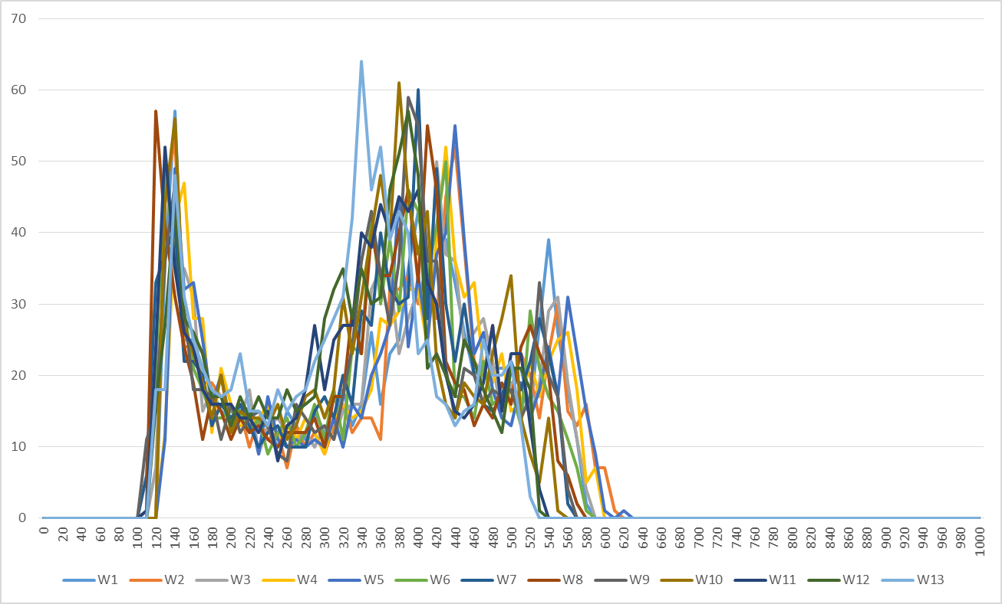
INTERLAN (tens of Gbps freq) 1Q2024
www.naquadria.it
SEE 12 | 22-23 April 2024 | Athens, Greece

Slide 22
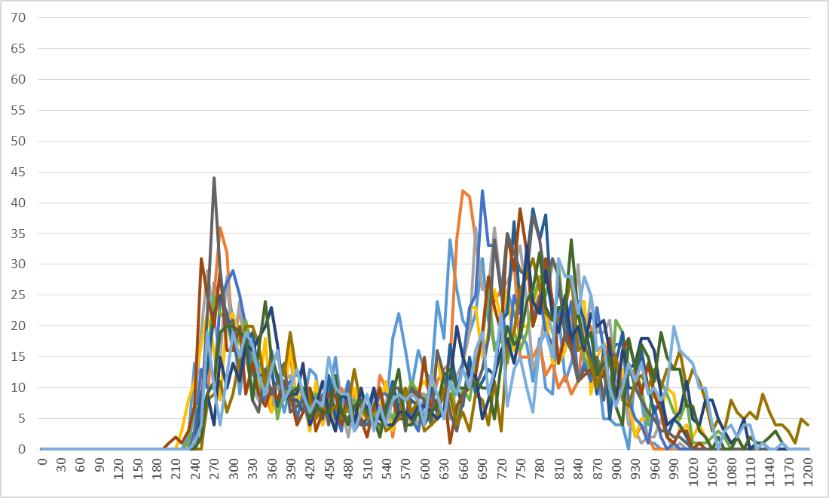
INEX (tens of Gbps freq) 1Q2024
www.naquadria.it
SEE 12 | 22-23 April 2024 | Athens, Greece

Slide 23
Weekly Correlation GR-IX 1Q2024
www.naquadria.it
SEE 12 | 22-23 April 2024 | Athens, Greece

Slide 24
Weekly Correlation INTERLAN 1Q2024
www.naquadria.it
SEE 12 | 22-23 April 2024 | Athens, Greece

Slide 25
Weekly Correlation CIX 1Q2024
www.naquadria.it
SEE 12 | 22-23 April 2024 | Athens, Greece

Slide 26
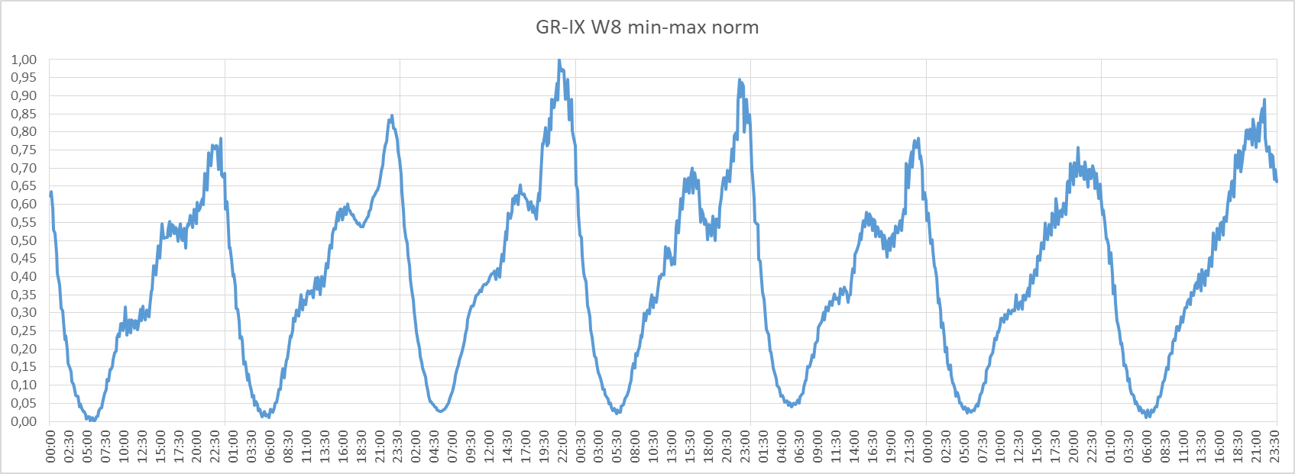
min-max normalization
www.naquadria.it
SEE 12 | 22-23 April 2024 | Athens, Greece

Slide 27
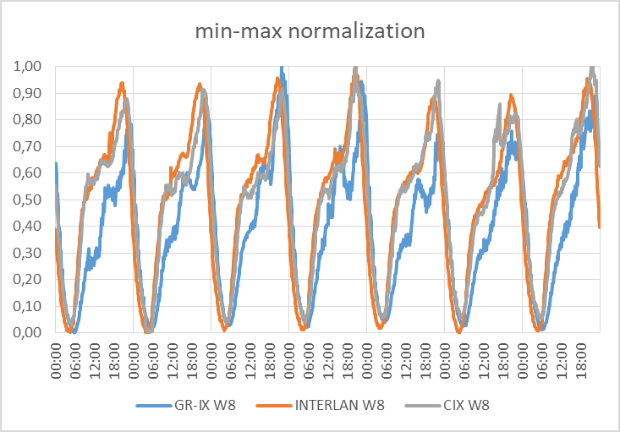
min-max normalization
www.naquadria.it
SEE 12 | 22-23 April 2024 | Athens, Greece

Slide 28
z-score normalization
www.naquadria.it
SEE 12 | 22-23 April 2024 | Athens, Greece

Slide 29
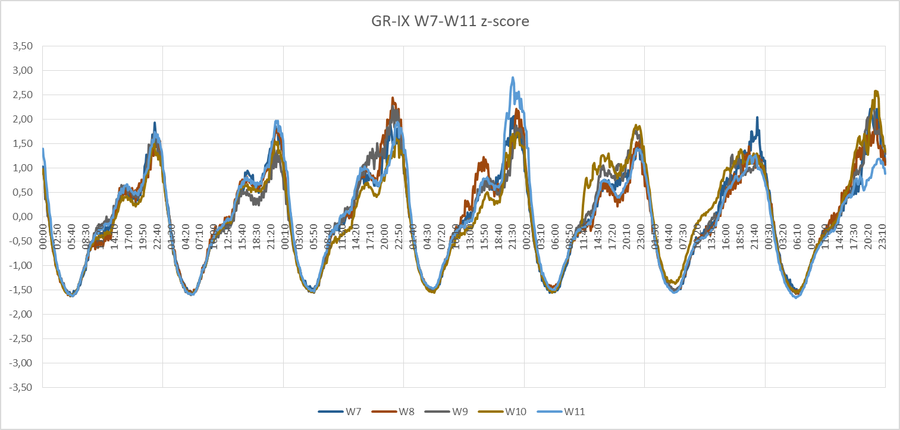
z-score normalization
www.naquadria.it
SEE 12 | 22-23 April 2024 | Athens, Greece

Slide 30
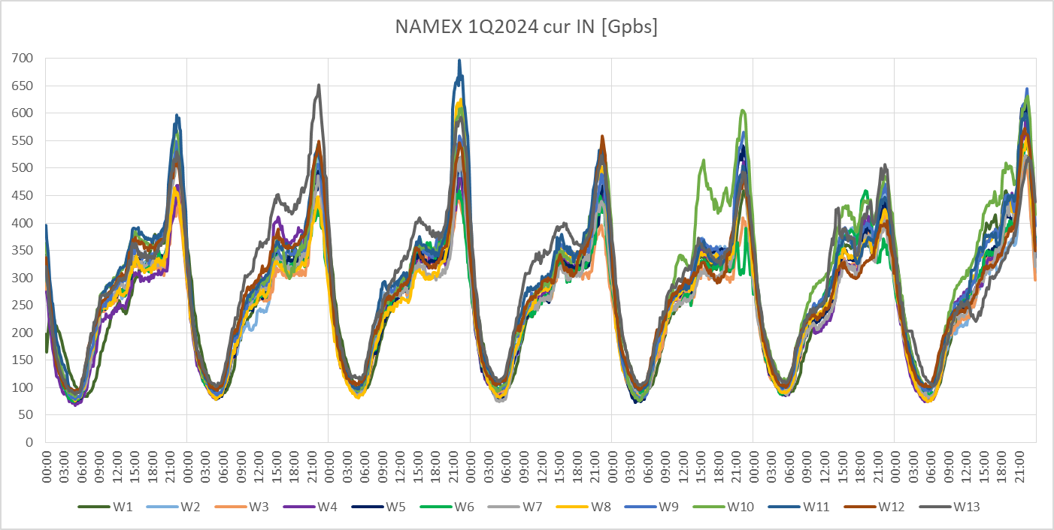
NAMEX 1Q2024
www.naquadria.it
SEE 12 | 22-23 April 2024 | Athens, Greece

Slide 31
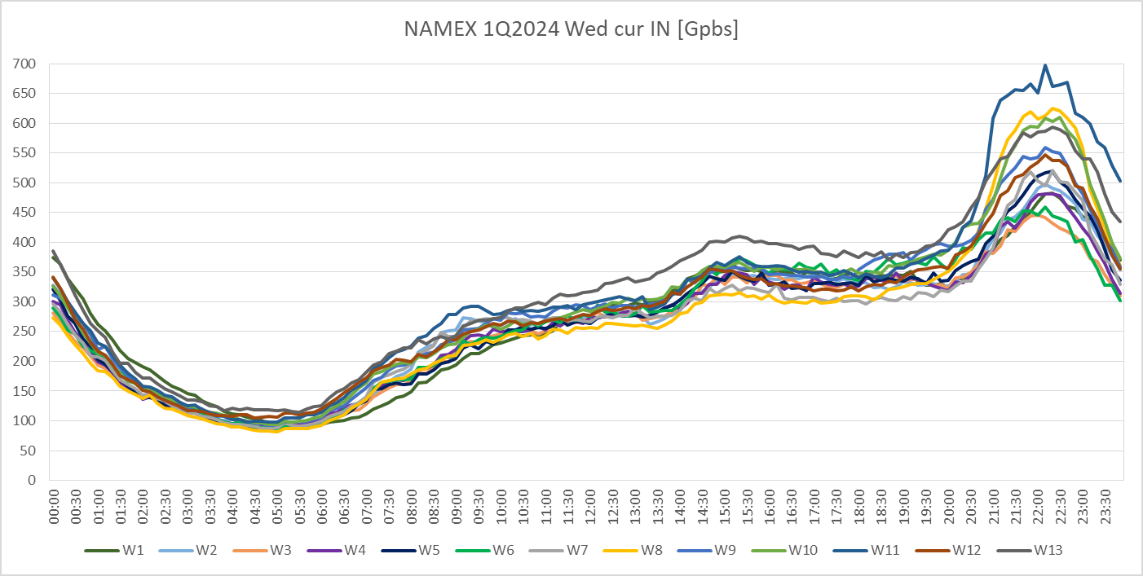
NAMEX 1Q2024 Wed
www.naquadria.it
SEE 12 | 22-23 April 2024 | Athens, Greece

Slide 32
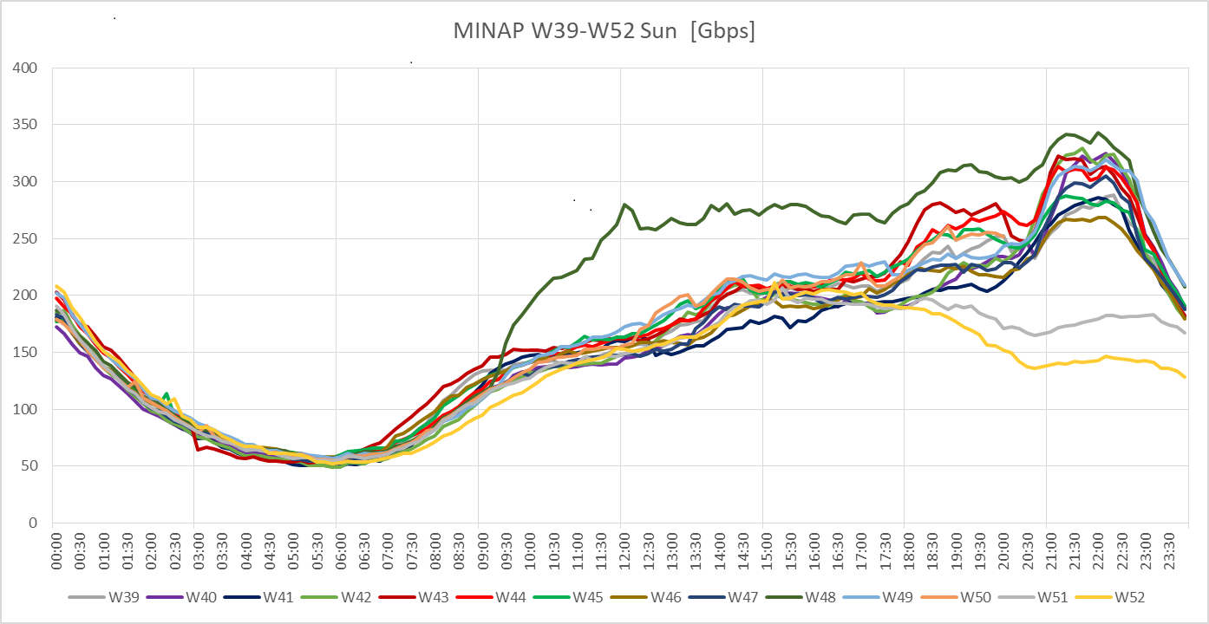
Ex. EVALUATING DEVIATIONS
www.naquadria.it
SEE 12 | 22-23 April 2024 | Athens, Greece

Slide 33
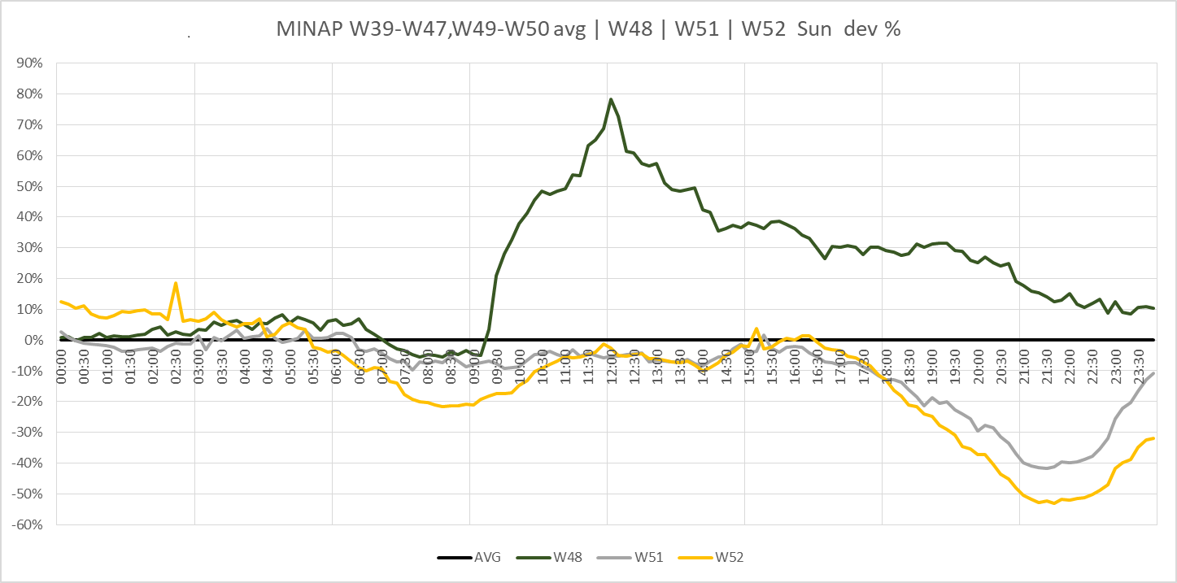
EVALUATING DEVIATIONS / 2
www.naquadria.it
SEE 12 | 22-23 April 2024 | Athens, Greece

Slide 34
EVALUATING DEVIATIONS / 3
https://www.linkedin.com/pulse/some-notes-sunday-traffic-part-1-minap-gianluca-sironi-mq0le
https://www.linkedin.com/pulse/some-notes-sunday-traffic-part-2-namex-gianluca-sironi-zkt7f
https://www.linkedin.com/pulse/some-notes-sunday-traffic-part-3-inex-gianluca-sironi-4vrff
www.naquadria.it
SEE 12 | 22-23 April 2024 | Athens, Greece

Slide 35
GR-IX weekly stats 1Q2024
www.naquadria.it
SEE 12 | 22-23 April 2024 | Athens, Greece

Slide 36
INTERLAN weekly stats 1Q2024
www.naquadria.it
SEE 12 | 22-23 April 2024 | Athens, Greece

Slide 37
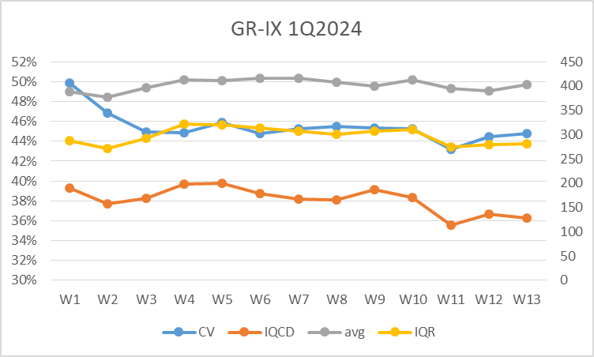
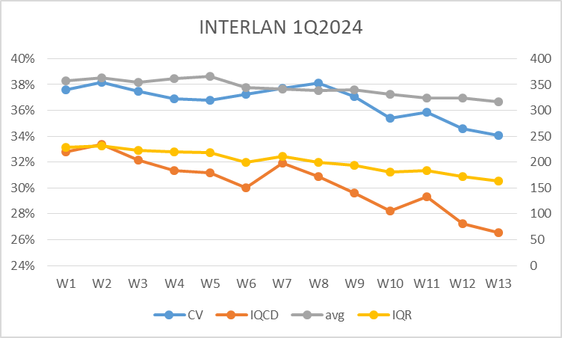
1Q2024 Trends examples
www.naquadria.it
SEE 12 | 22-23 April 2024 | Athens, Greece

Slide 38
NEXT STEPS
EXTEND IXPs set starting from IXPmanager based IXPs ( WIP with other IXPs )
PUBLISH AND SHARE DATASETS dataset format (CSV?) available for IXs | reasearch | everybody ? e.g. on yearly basis {IXP}-YYYY.csv updated weekly(/daily?)
METRICS & ANALYTICS define, agree (and share) a set of metrics, parameters, features, scaling factors/functions, «classification» (?)
KNOWLEDGE SHARING <<<<<<<<
www.naquadria.it
SEE 12 | 22-23 April 2024 | Athens, Greece

Slide 39
QUESTIONS?
THOUGHTS?
(suggestions are welcome)
www.naquadria.it
SEE 12 | 22-23 April 2024 | Athens, Greece

Slide 40
THANK YOU
Gianluca Sironi NAQUADRIA | PCIX
www.naquadria.it
SEE 12 | 22-23 April 2024 | Athens, Greece

